Slide 1
Task Scheduler
Team Name: BTS
Team Members:
Brahmaiah
Tharun

Slide 2
Description
This product helps users to plan their tasks and monitor them.
Allows users to create varied type of tasks.
Product has notification service which will notify users before their deadline.
User can update the tasks.
Data will be secured.
Mark tasks as completed once they are done.

Slide 3
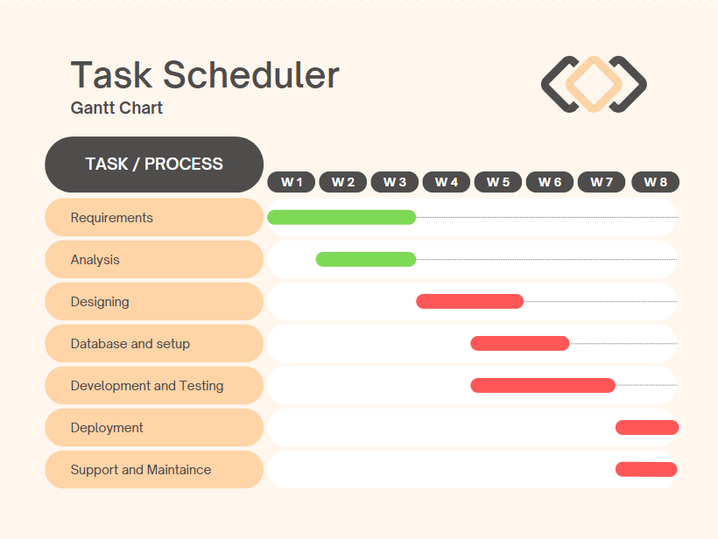

Slide 4
Technologies Used (Brahmaiah)
Front End
HTML
CSS
JavaScript

Slide 5
Technologies Used (Tharun)
Back End
Python/ NodeJS
MongoDB

Slide 6
Login & Signup
Page

Slide 7
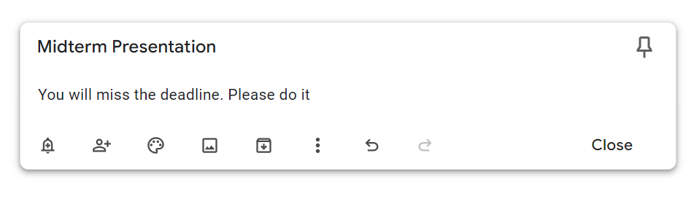
Task Creation

Slide 8
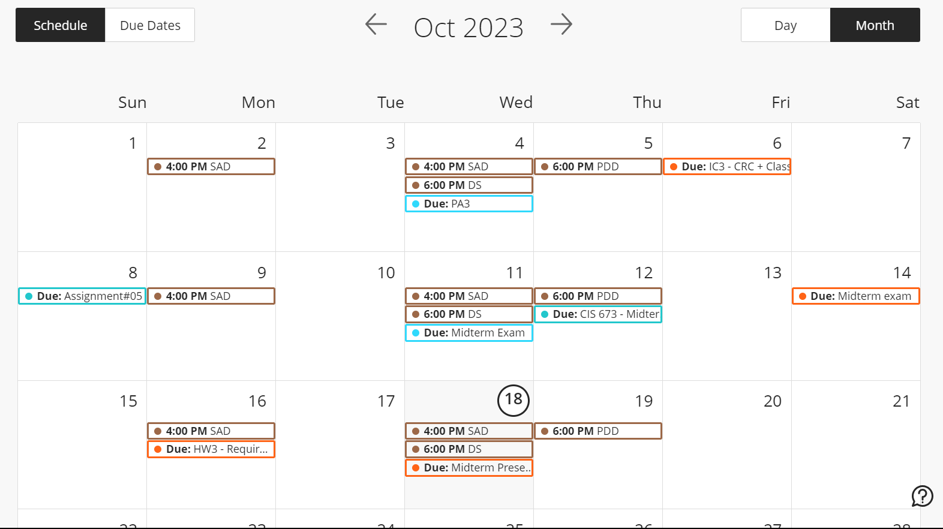
List of tasks

Slide 9
Thank You

